Slide 1

Academic Session 2026-27
ODD Semester July-Dec 2026
UNIVERSITY INSTITUTE OF ENGINEERING AND TECHNOLOGY
Department of TT
Bachelor of Engineering (B.E.) – CSE
Advanced Data Structures / Semester 3
(CS221)
Unit No. 1 Chapter No. 1.1 Lecture No. 8
Topic : Introduction to Sorting Techniques
Abhishek Thakur (E19789) Technical Trainer
Sourav Jaiswal (E19756)-MSC Technical Trainer

Slide 2
Learning Objectives
Understand what sorting is and why it is fundamental in computer science.
Classify sorting algorithms into comparison-based and non-comparison-based.
Identify in-place vs. out-of-place and stable vs. unstable sorting algorithms.
Compare the time and space complexities of major sorting algorithms.

Slide 3

What is Sorting and Why it Matters?
Sorting: The process of arranging data elements in a specific order — ascending or descending.
Importance: Sorted data enables binary search (O(log n) vs O(n)), simplifies data analysis, and is prerequisite for many algorithms.
In-place: Algorithm sorts within the original array using O(1) extra space (e.g. Bubble, Quick Sort).
Stable: A stable sort preserves the relative order of equal elements (e.g. Merge Sort, Insertion Sort).
Adaptive: Runs faster on partially sorted input.

Slide 4
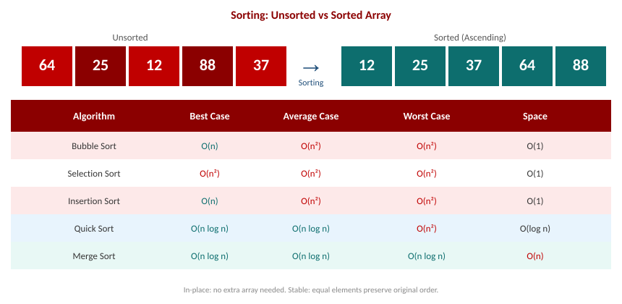
Sorting Algorithms — Complete Complexity Comparison

Slide 5
Classification of Sorting Algorithms
Comparison-based: Compare elements to determine order. Lower bound is O(n log n). Examples: Bubble, Merge, Quick, Heap Sort.
Non-comparison: Use element values directly (not comparisons). Can achieve O(n). Examples: Counting Sort, Radix Sort, Bucket Sort.
Internal sorting: All data fits in main memory during sorting (most algorithms discussed here).
External sorting: Data too large for RAM; stored on disk. Merge Sort is commonly adapted for external sorting.

Slide 6
Summary of the Lecture
Sorting arranges elements in order; it is a prerequisite for binary search and many algorithms.
In-place algorithms use O(1) extra space; stable algorithms preserve the order of equal elements.
Comparison-based sorts have a lower bound of O(n log n); non-comparison sorts can be O(n).
Bubble, Insertion, Selection Sort are O(n sq.) — simple but slow for large datasets.
Quick Sort and Merge Sort are O(n log n) on average — preferred for large datasets.

Slide 7

Next Lecture
Bubble Sort — detailed algorithm, step-by-step trace, and complexity analysis.

Slide 8
Quiz/ FAQ's
Q1. What is the difference between a stable and an unstable sorting algorithm? Give one example each.
Q2. Why is the theoretical lower bound for comparison-based sorting O(n log n)?
Q3. When would you choose Insertion Sort over Merge Sort despite its O(n sq.) worst case?

Slide 9
References/ Articles
Cormen et al., Introduction to Algorithms (CLRS), 3rd Ed., MIT Press, Ch. 2, 6-9.
GeeksforGeeks — Sorting Algorithms: https://www.geeksforgeeks.org/sorting-algorithms/
Visualgo — Sorting: https://visualgo.net/en/sorting

Slide 10
Thank You
For queries
Email: abhishek.e19789@cumail.in

